Slide 1
UNIT 1 : Set theory

Slide 2
SETS AND ELEMENTS, SUBSETS
A set may be viewed as any well-defined collection of objects, called the elements or members of the set.
One usually uses capital letters, A, B, X, Y, . . . , to denote sets, and lowercase letters, a, b, x, y, . . ., to denote elements of sets.
Synonyms for “set” are “class,” “collection,” and “family.”

Slide 3
Membership
Membership in a set is denoted as follows: a ∈ S denotes that a belongs to a set S a, b ∈ S denotes that a and b belong to a set S Here ∈ is the symbol meaning “is an element of.” We use ∈ to mean “is not an element of.”

Slide 4
Specifying Sets
There are essentially two ways to specify a particular set.
One way, if possible, is to list its members separated by commas and contained in braces { }.
A = {1, 3, 5, 7, 9}
That is, A consists of the numbers 1, 3, 5, 7, 9.

Slide 5
A second way is to state those properties which characterized the elements in the set.
B = {x | x is an even integer, x > 0}
The second set, which reads:
B is the set of x such that x is an even integer and x is greater than 0,

Slide 6
EXAMPLE
(a) A = {x | x is an odd positive integer, x < 10}.
(b) B = {2, 4, 6,...}
Observe that 8 ∈ B, but 3 ∈/ B.
(c) Let E = {x | x2 − 3x + 2 = 0},
F = {2, 1} and G = {1, 2, 2, 1}.
Then E = F = G

Slide 7
Subsets
Suppose every element in a set A is also an element of a set B, that is, suppose a ∈ A implies a ∈ B.
Then A is called a subset of B.
We also say that A is contained in B or that B contains A.
This relationship is written A ⊆ B or B ⊇ A Two sets are equal if they both have the same elements or, equivalently, if each is contained in the other.
That is: A = B if and only if A ⊆ B and B ⊆ A If A is not a subset of B, that is, if at least one element of A does not belong to B, we write A ⊆ B.

Slide 8
EXAMPLE
A = {1, 3, 4, 7, 8, 9}, B = {1, 2, 3, 4, 5}, C = {1, 3}
Then C ⊆ A and C ⊆ B since 1 and 3, the elements of C, are also members of A and B.
But B ⊆ A since some of the elements of B, e.g., 2 and 5, do not belong to A.
Similarly, A ⊆ B.

Slide 9
Special symbols
Some sets will occur very often in the text, and so we use special symbols for them.
Some such symbols are:
N = the set of natural numbers or positive integers: 1, 2, 3,...
Z = the set of all integers: ..., −2, −1, 0, 1, 2,...
Q = the set of rational numbers
R = the set of real numbers C = the set of complex numbers
Observe that N ⊆ Z ⊆ Q ⊆ R ⊆ C.

Slide 10
Universal Set, Empty Set
All sets under investigation in any application of set theory are assumed to belong to some fixed large set called the universal set which we denote by U unless otherwise stated or implied.
Given a universal set U and a property P, there may not be any elements of U which have property P. For example, the following set has no elements: S = {x | x is a positive integer, x2 = 3} Such a set with no elements is called the empty set or null set and is denoted by ∅ There is only one empty set.
That is, if S and T are both empty, then S = T , since they have exactly the same elements, namely, none.
The empty set ∅ is also regarded as a subset of every other set. Thus we have the following simple result which we state formally.
For any set A, we have ∅ ⊆ A ⊆ U

Slide 11
Disjoint Sets
Two sets A and B are said to be disjoint if they have no elements in common.
For example, suppose A = {1, 2}, B = {4, 5, 6}, and C = {5, 6, 7, 8} Then A and B are disjoint, and A and C are disjoint.
But B and C are not disjoint since B and C have elements in common, e.g., 5 and 6.
We note that if A and B are disjoint, then neither is a subset of the other (unless one is the empty set).

Slide 12
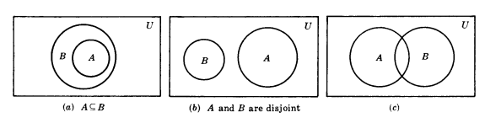
VENN DIAGRAMS

Slide 13
EXAMPLE
S1: All my tin objects are saucepans.
S2: I find all your presents very useful.
S3: None of my saucepans is of the slightest use.

Slide 14
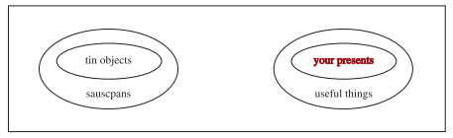
S : Your presents to me are not made of tin.

Slide 15
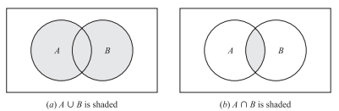
SET OPERATIONS
Union and Intersection
A ∪ B = {x | x ∈ A or x ∈ B}
A ∩ B = {x | x ∈ A and x ∈ B}

Slide 16
EXAMPLE
Let A = {1, 2, 3, 4},
B = {3, 4, 5, 6, 7},
C = {2, 3, 8, 9}.
Then

Slide 17
Solution
A ∪ B = {1, 2, 3, 4, 5, 6, 7},
A ∪ C = {1, 2, 3, 4, 8, 9},
B ∪ C = {2, 3, 4, 5, 6, 7, 8, 9},
A ∩ B = {3, 4},
A ∩ C = {2, 3},
B ∩ C = {3}.

Slide 18
EXAMPLE
Let U be the set of students at a university, and let M denote the set of male students and let F denote the set of female students. The U is the disjoint union of M of F;
U = M ∪ F and M ∩ F = ∅

Slide 19
Complements, Differences, Symmetric Differences
The absolute complement or, simply, complement of a set A, denoted by AC, is the set of elements which belong to U but which do not belong to A.
That is, AC = {x | x ∈ U,x /∈ A}

Slide 20
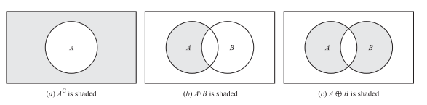
Venn Diagram

Slide 21
The relative complement of a set B with respect to a set A or, simply, the difference of A and B, denoted by A\B, is the set of elements which belong to A but which do not belong to B;
that is A\B = {x | x ∈ A, x /∈ B}
The set A\B is read “A minus B.” Many texts denote A\B by A − B or A ∼ B.

Slide 22
The symmetric difference of sets A and B, denoted by A ⊕ B, consists of those elements which belong to A or B but not to both.
That is, A ⊕ B = (A ∪ B)\(A ∩ B) or A ⊕ B = (A\B) ∪ (B\A)

Slide 23
EXAMPLE
Suppose U = N = {1, 2, 3,...} is the universal set.
Let A = {1, 2, 3, 4}, B = {3, 4, 5, 6, 7}, C = {2, 3, 8, 9}, E = {2, 4, 6,...}
(Here E is the set of even integers.) Then: AC = {5, 6, 7,...}, BC = {1, 2, 8, 9, 10,...}, EC = {1, 3, 5, 7,...}
That is, EC is the set of odd positive integers.
Also: A\B = {1, 2}, A\C = {1, 4}, B\C = {4, 5, 6, 7}, A\E = {1, 3}, B\A = {5, 6, 7}, C\A = {8, 9}, C\B = {2, 8, 9}, E\A = {6, 8, 10, 12,...}.
Furthermore: A ⊕ B = (A\B) ∪ (B\A) = {1, 2, 5, 6, 7}, B ⊕ C = {2, 4, 5, 6, 7, 8, 9}, A ⊕ C = (A\C) ∪ (B\C) = {1, 4, 8, 9}, A ⊕ E = {1, 3, 6, 8, 10,...}.

Slide 24
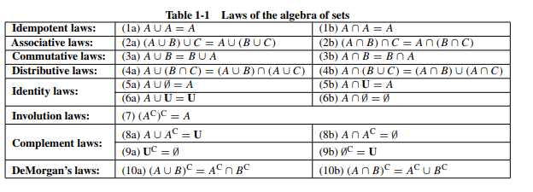
ALGEBRA OF SETS, DUALITY

Slide 25
DeMorgan’s Law
(A ∪ B)C = {x | x /∈ (A or B)}={x | x /∈ A and x /∈ B} = AC ∩ BC
Here we use the equivalent (DeMorgan’s) logical law:
¬(p ∨ q) = ¬p ∧ ¬q
where ¬ means “not,” ∨ means “or,” and ∧ means “and.”

Slide 26
Duality
Suppose E is an equation of set algebra.
The dual E∗ of E is the equation obtained by replacing each occurrence of ∪, ∩, U and ∅ in E by ∩, ∪, ∅, and U, respectively.
For example, the dual of (U ∩ A) ∪ (B ∩ A) = A is (∅ ∪ A) ∩ (B ∪ A) = A

Slide 27
FINITE SETS, COUNTING PRINCIPLE
Sets can be finite or infinite. A set S is said to be finite if S is empty or if S contains exactly m elements where m is a positive integer; otherwise S is infinite.

Slide 28
EXAMPLE
(a) The set A of the letters of the English alphabet and the set D of the days of the week are finite sets.
Specifically, A has 26 elements and D has 7 elements.
(b) Let E be the set of even positive integers, and let I be the unit interval, that is, E = {2, 4, 6,...} and I = [0, 1]={x | 0 ≤ x ≤ 1}
Then both E and I are infinite.
A set S is countable if S is finite or if the elements of S can be arranged as a sequence, in which case S is said to be countably infinite;
otherwise S is said to be uncountable.
The above set E of even integers is countably infinite, whereas one can prove that the unit interval I = [0, 1] is uncountable.

Slide 29
Counting Elements in Finite Sets
The notation n(S) or |S| will denote the number of elements in a set S. (Some texts use #(S) or card(S) instead of n(S).)
Thus n(A) = 26, where A is the letters in the English alphabet, and n(D) = 7, where D is the days of the week.
Also n(∅) = 0 since the empty set has no elements.

Slide 30
CLASSES OF SETS, POWER SETS, PARTITIONS
Given a set S, we might wish to talk about some of its subsets.
Thus we would be considering a set of sets. Whenever such a situation occurs, to avoid confusion, we will speak of a class of sets or collection of sets rather than a set of sets.
If we wish to consider some of the sets in a given class of sets, then we speak of subclass or subcollection.

Slide 31
EXAMPLE
Suppose S = {1, 2, 3, 4}.
(a Let A be the class of subsets of S which contain exactly three elements of S. Then
A = [{1, 2, 3},{1, 2, 4},{1, 3, 4},{2, 3, 4}]
That is, the elements of A are the sets {1, 2, 3}, {1, 2, 4}, {1, 3, 4}, and {2, 3, 4}.

Slide 32
EXAMPLE
Let B be the class of subsets of S, each which contains 2 and two other elements of S. Then
B = [{1, 2, 3},{1, 2, 4},{2, 3, 4}]
The elements of B are the sets {1, 2, 3}, {1, 2, 4}, and {2, 3, 4}. Thus B is a subclass of A, since every element of B is also an element of A. (

Slide 33
Power Sets
For a given set S , we may speak of the class of all subsets of S.
This class is called the power set of S , and will be denoted by P(S). If S is finite, then so is P(S).
In fact, the number of elements in P(S) is 2 raised to the power n(S).
That is, n(P (S)) = 2n(S)
(For this reason, the power set of S is sometimes denoted by 2S.)

Slide 34
EXAMPLE
Suppose S = {1, 2, 3}.
Then P (S) = [∅,{1},{2},{3},{1, 2},{1, 3},{2, 3}, S]
Note that the empty set ∅ belongs to P(S) since ∅ is a subset of S. Similarly, S belongs to P(S).
As expected from the above remark, P(S) has 2^3 = 8 elements.

Slide 35
Partitions
Let S be a nonempty set. A partition of S is a subdivision of S into non-overlapping, nonempty subsets.
Precisely, a partition of S is a collection {Ai} of nonempty subsets of S such that:
(i) Each a in S belongs to one of the Ai.
(ii) The sets of {Ai} are mutually disjoint; that is, if
Aj = Ak then Aj ∩ Ak = ∅

Slide 36
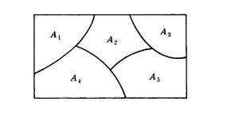
The subsets in a partition are called cells. Figure is a Venn diagram of a partition of the rectangular set S of points into five cells, A1, A2, A3, A4, A5.

Slide 37
EXAMPLE
Consider the following collections of subsets of S = {1, 2, . . ., 8, 9}:
(i) [{1, 3, 5}, {2, 6}, {4, 8, 9}]
(ii) [{1, 3, 5}, {2, 4, 6, 8}, {5, 7, 9}]
(iii) [{1, 3, 5}, {2, 4, 6, 8}, {7, 9}]
Then (i) is not a partition of S since 7 in S does not belong to any of the subsets.
Furthermore, (ii) is not a partition of S since {1, 3, 5} and {5, 7, 9} are not disjoint.
On the other hand, (iii) is a partition of S.

